Slide 1

An Introduction to
Computer Programming
Notes:
This project was supported by a grant from CIRA's Community Investment Program.

Slide 2
Inspire & Empower
Canadian Children with
CODE
We are a Canadian not for profit organization dedicated to empowering kids, teachers and parents with the skills we all need to thrive in a technology driven society.
By teaching kids how to code we teach them how
to be better thinkers and better creators in a
digital world.

Slide 3
What is a computer?
Notes:
Instructor notes: Ask the participants Q. What is your relationship with technology? Some answers we’ve seen: Love/Hate/Addiction/Tool…
Q. What does a computer mean to you?

Slide 4
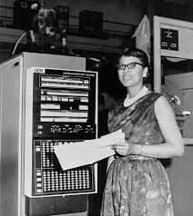
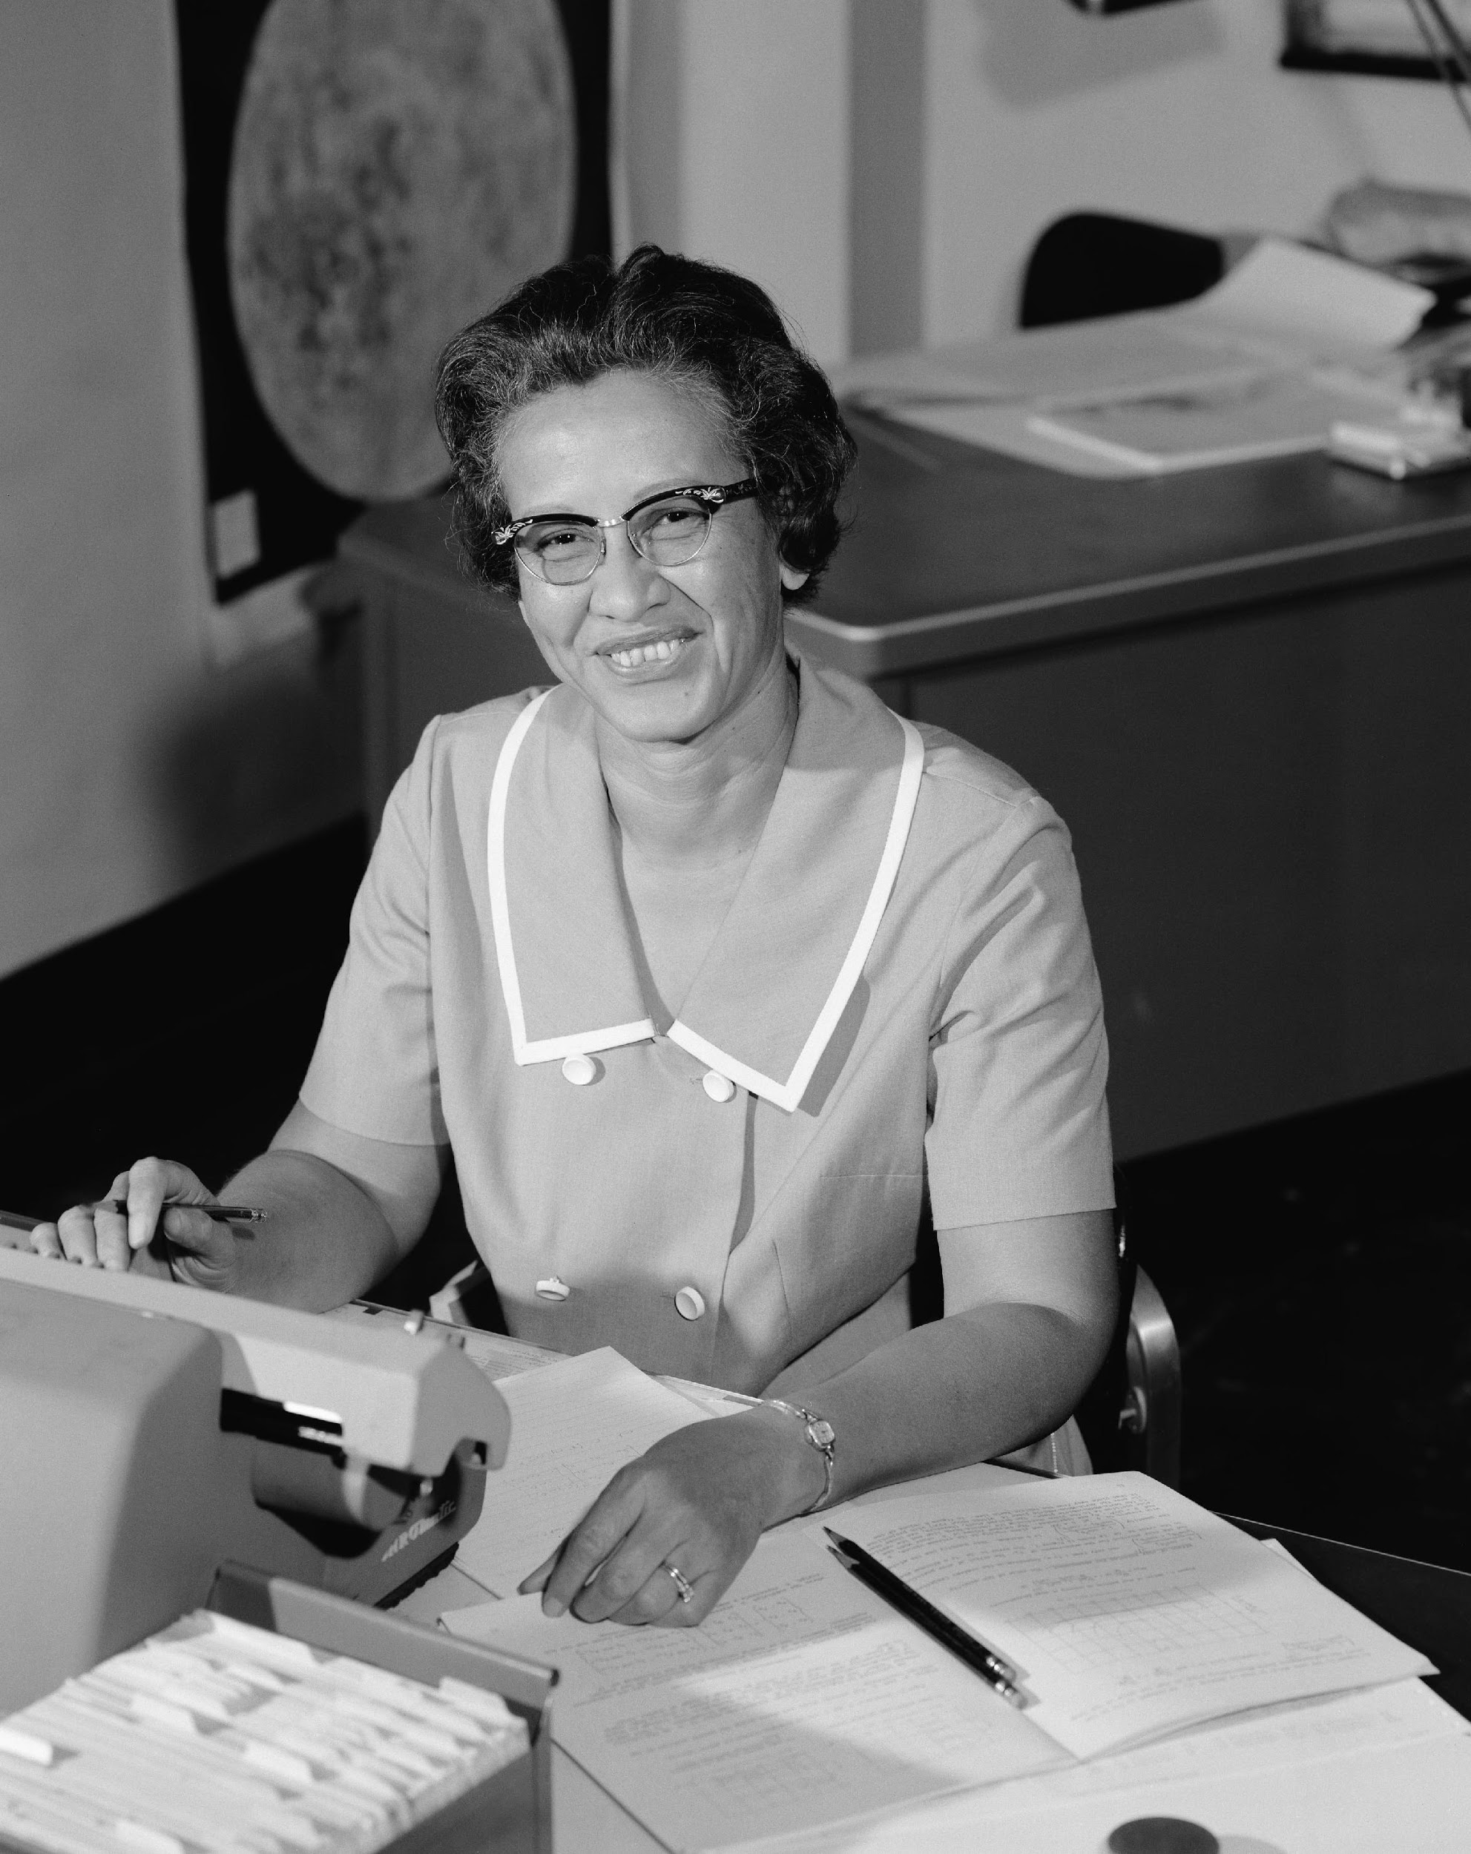
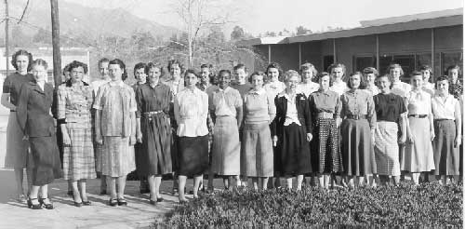
The FIRST computers
were humans!
They were very skilled
in math and sciences
and solved complex mathematical equations and calculations
by hand.
Melba Roy (NASA)
Katherine Johnson 1966 (NASA)
Most computers
were women.
Human Computers (NASA)
Notes:
Why women? At the time, men liked the hardware aspect and left it to women to figure out how to program the computers! They are some of the women who helped put Man on the Moon.
A large number of women in the 1930’s were getting advanced Math degrees from Universities, most would go into teaching. However with World War II, they were recruited to help in the military and women of color were included in the recruitment. The military wanted the very best.
https://crgis.ndc.nasa.gov/historic/Human_Computers
Image with desks: Human Computers at Langley, USA (NASA) Image with women: Human Computers from NASA (“When Computers wore skirts”)

Slide 5

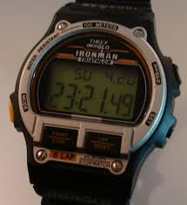

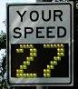
TODAY A computer is
a programmable machine that can Store,
Retrieve,
and
Process DATA
Notes:
Today, a computer is a programmable machine (usually electronic)
Computers:
Come in different shapes and sizes, can be simple or very complex depending on the tasks
Two characteristics of computers
1. Responds to a specific set of instructions in a well-defined manner
2. Can execute a pre-recorded list of instructions (a program)

Slide 6
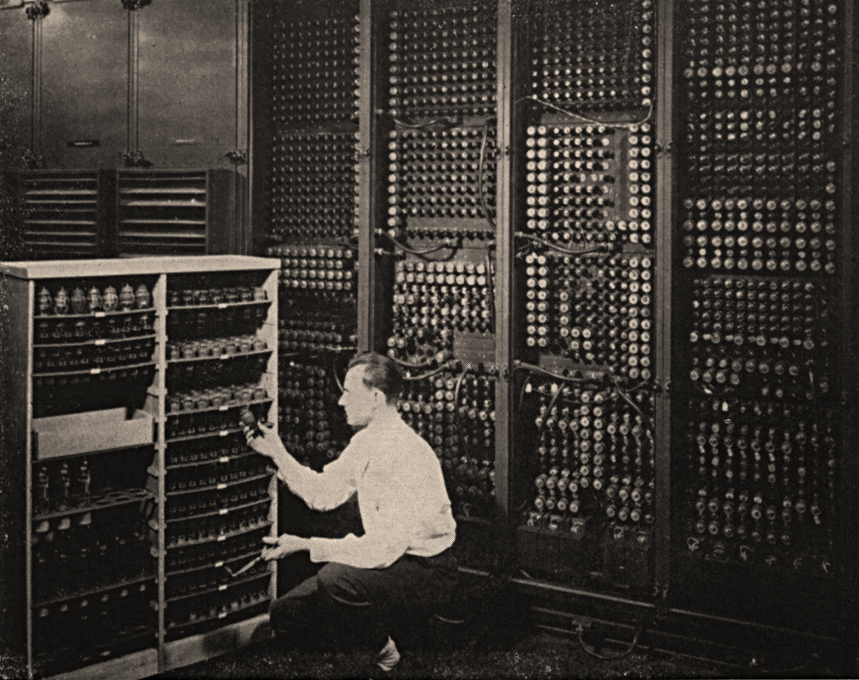
A computer is made up of
Hardware what we can physically touch
Software
data and instructions
ENIAC (Electronic Numerical Integrator And Computer) 1946 -1955
Notes:
http://www.computerhistory.org/revolution/birth-of-the-computer/4/78: ENIAC
Background: ENIAC – Replacing a bad tube meant checking among the computer’s 19 000 possibilities. A computer is a programmable machine.
Modern computers are electronic and digital:
Hardware: what we can physically touch (the actual machinery): circuits, wires, hard drives, memory chips, speakers, vieo card, motherboard, computer case, monitor, mouse, keyboard, etc...
Software: data and instructions allowing a computer to perform a specific task

Slide 7
Do computers have brains?
Notes:
Ask the question to the audience and ask people to raise their hands in they think “Yes”, “No”, “Not Sure”.
The answer is “No”. Computers do not have brains, they do what someone has told them to do: the instructions are the software running on the computer. If a computer “appears” to think, it is simply processing vast quantities of information very quickly.

Slide 8
UNPLUGGED Exercise!
Notes:
Let’s go through an exercise:
This unplugged activity is used to illustrate
- what it takes to communicate with a computer: instructions must be detailed and precise. - different practices in computer programming: planning, collaborating, debugging, experimenting

Slide 9
STEP 1
Get into groups of 2
STEP 2
Each group takes out
one piece of paper
one pencil
STEP 3
Choose who will be
the Programmer
the Computer
Unplugged challenge
SETUP

Slide 10
COMPUTER
Do exactly what the programmer says
You remain silent
PROGRAMMER
Hands behind your back
Give instructions to the to draw the picture
Use only basic shapes
Unplugged challenge
INSTRUCTIONS
Notes:
We will be showing the programmers a picture…

Slide 11
Everyone ready?
Computers
close your eyes!
Unplugged
challenge READY?
Notes:
52

Slide 12

Programmers:
Only use basic shapes
Hands off !

Slide 13
Computers
open your eyes!
draw exactly what the programmer tells you
you remain silent!
Unplugged challenge SET…
Notes:
You have 3 minutes!
https://www.google.ca/?gws_rd=ssl#q=stopwatch

Slide 14
GO!
Notes:
Ask the participants - What did they learned ?
- What are the strategies they employed once they switched places? 1. Collaborate with each other (computer and programmer) to re-create the picture. 2. Experimented with different ways to give instructions to the computer
3. Debugging:

Slide 15
COMPUTER
Do exactly what the programmer says
You remain silent
PROGRAMMER
Hands behind your back
Give instructions to the to draw the picture
Use only basic shapes
Let’s switch places!
Notes:
52

Slide 16
Everyone ready?
Computers
close your eyes!
Unplugged challenge READY?
Notes:
52

Slide 17
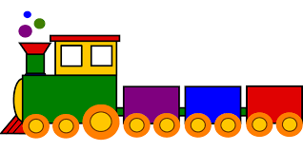
Programmers Only use basic shapes
Hands off !
Notes:
52

Slide 18
Computers
open your eyes!
draw exactly what the programmer tells you
you remain silent!
Unplugged
challenge SET…

Slide 19
GO!
Notes:
Ask the participants - What did they learned ?
- What are the strategies they employed once they switched places? 1. Collaborate with each other (computer and programmer) to re-create the picture. 2. Experimented with different ways to give instructions to the computer
3. Debugging:

Slide 20
What are some of the things we learned during this activity?
Notes:
Ask the participants - What did they learned ?
- What are the strategies they employed once they switched places? 1. Collaborate with each other (computer and programmer) to re-create the picture. 2. Experimented with different ways to give instructions to the computer
3. Debugging:

Slide 21




COMPUTATIONAL
< Planning >
< Collaborating>
< Experimenting >
< Debugging >
<PRACTICES>
THINKING
{CONCEPTS}
{ Algorithms }
{ Decomposition }
{ Abstraction }
{ Pattern Recognition }
{ Logic }
/PERSPECTIVES/
/ Expressing /
/ Understanding /
/ Connecting /
Notes:
Instructor notes Introduce this as the big picture. Three key dimensions to Computational Thinking (Brennan & Resnick, AERA 2012): computational concepts, computational practices, computational perspectives
They are concepts that you already master, whether formally or not (you may be better at some than others…which is true for everyone)
Explain it clockwise: Computational concepts put into action are Practices, and that leads to Perspectives.
Explain to teachers that even though some of these concepts might seem like a giant black-hole now, they already use and understand many of them daily as we will see in next set of slides
End on Perspectives as the reason why we would want to learn and teach computational thinking,
Concepts Concepts that designers use as they program; these concepts are common to all programming and transfer to non-programming contexts
Algorithm: a series of step-by-step instructions
Decomposition: breaking down a complex problem into simpler parts
Abstraction: keeping essential characteristics/information (from the latin abs- “away from” and “trahere” -draw)
Logic: Analyzing and predicting
Pattern Recognition: learning to identify and use similarities in order to: simply, shorten, apply similar solutions
Practices:
Practices designers develop as they program: it is the process of construction and design. Practices focus on the process of thinking and learning, moving beyond the “what” you are learning to the “how” you are learning.
Experimenting: trial and error, testing new things, having an idea and trying to see how to make it work (incremental & iterative process)
Debugging: Answering the question “Does it work the way I want it to?” If the answer is “No”, figure out why then fix it. (incremental & iterative process)
Collaboration:
Planning:
Perspectives:
Designers evolve their understanding of the technological world around them, their relationship with others, and of themselves.
Expressing = computer programming can be a means of expressing oneself because it is a tool, it can be used in many different ways (web pages, art, music, games, etc…) just like a pencil can be used to write a report or draw a picture.
Understanding = being better able to understand today’s sociotechno reality - being able to recognize and use some of the tools that create this reality
Connecting = creativity and learning are deeply social practice, facilitate being able to reach out to others in a new ways (creating with others and creating for others)

Slide 22
PRACTICES IN COMPUTER PROGRAMMING
Notes:
Instructor notes: Ask the participants Q. What is your relationship with technology? Some answers we’ve seen: Love/Hate/Addiction/Tool…
Q. What does a computer mean to you?

Slide 23


Collaborating
Experimenting
Practices
Notes:
Adults (and especially teachers) employ these practices all the time! What are examples of these practices in day-to-day life?
Experimenting: Cooking/Baking: improving a recipe, trying different combinations, different decorations…
Collaboration: For most things in life, you collaborate with others. For example in this workshop: (to the participants) You are being quiet, listening and participating. As the instructor, I am standing, speaking clearly and answering your questions.
Planning:
We usually plan things out when tasks are complex or unfamiliar. Ex.: For instance, how did you get here today? (for workshops that are not being held in the school) It is important to have a clear idea of what you are trying to accomplish.
Debugging: We all do this without thinking, it’s known as auto-correction (we see that we’ve made a mistake, we correct it and keep on going). Say when you’re parking your car, and you need to “re-adjust” or you buttoned your shirt and missed a button.

Slide 24


Planning
Debugging
Practices
Notes:
Adults (and especially teachers) employ these practices all the time! What are examples of these practices in day-to-day life?
Experimenting: Cooking/Baking: improving a recipe, trying different combinations, different decorations…
Collaboration: For most things in life, you collaborate with others. For example in this workshop: (to the participants) You are being quiet, listening and participating. As the instructor, I am standing, speaking clearly and answering your questions.
Planning:
We usually plan things out when tasks are complex or unfamiliar. Ex.: For instance, how did you get here today? (for workshops that are not being held in the school) It is important to have a clear idea of what you are trying to accomplish.
Debugging: We all do this without thinking, it’s known as auto-correction (we see that we’ve made a mistake, we correct it and keep on going). Say when you’re parking your car, and you need to “re-adjust” or you buttoned your shirt and missed a button.

Slide 25
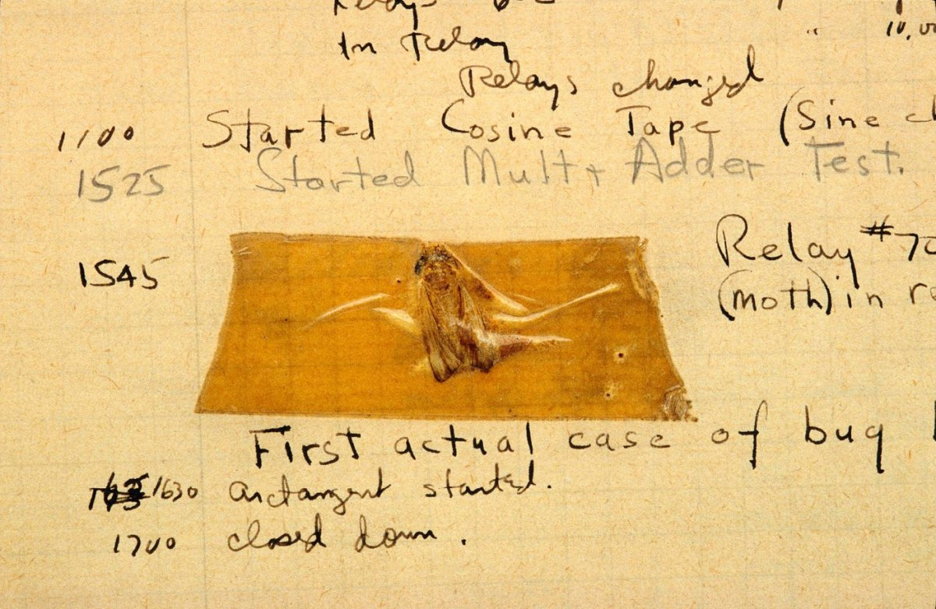
The first “real” computer bug
DEBUGGING
Does it work the way it is suppose to? Identifying the cause and fixing it or finding a work-around.
From Grace Hopper’s log, 1947
Notes:
Debugging: Answering the question “Does it work the way I want it to?” If the answer is “No”, figure out why then fix it. (incremental & iterative process)
Things rarely (if ever) work just as imagined, it is critical fro designers to develop strategies for dealing with - and anticipating – anticipating problems.
A little trivia:
This is the very first instance of a “real” computer bug: a moth found in the computer - from Grace Hopper’s blog
The term “bug” was popularized by Grace Hopper.
Grace Hopper, a famous computer scientist, is credited for popularizing the term “debugging”. In Computer programming, debugging means getting rid of problems in the code. One of Grace Hopper’s computer glitches was actually being caused by a moth in the back of her computer! Debugging has become a very important programming technique because the more code there is, the more potential for bugs there are!
Computer programmers usually say: If your program runs perfectly the first time, ask yourself the question “Why did it work?”

Slide 26
How do humans communicate with computers?
Notes:
Communicating with a computer: instructions must be detailed and precise.

Slide 27
What does the word
CODE
mean to you?
Notes:
Question to the audience: Name types of codes other than computer programming?
Some answers
Code of conduct
Code of ethics
Dress code
Morse code
Emoticons
Facial expressions
Languages (spoken, written, sign)
Colour codes
The word code means many things to many people. Secret codes, codes of conduct, codes that organize information, like colour coding, or codes that tell us what to do in a crisis. Humans seem to be built to code and de-code. If you’ve learned to read, learned basic math, learned a recipe, you’ve already developed some coding skills that you can transfer to the project of learning computer code.
So, you already know how to code, you are simply learning one more way to do it.

Slide 28

HUMAN-FRIENDLY
LANGUAGE
Computers need instructions written in machine-code…
TRANSLATOR
MACHINE-CODE
Notes:
Computer code is how instructions are given to a computer to perform a specific task.
Computers understand binary code: that is sequences of ones and zeros.
At the beginning of modern computing, a major issue preventing the wider use of computers: there was no way for anyone who was not highly trained and
highly mathematical to program computers. Grace Hopper and her team created the first compiler for computer languages: the computer would take
instructions written in a human-friendly language and translate them into machine code. (In computing science, such a translator is called a compiler.)
Humans are built to code and de-code information.
If you’ve learned to read and write, learned basic math, learned a recipe, you’ve already developed some coding skills that you can transfer to the project of learning computer code.
YOU ALREADY KNOW HOW TO CODE!
You are just learning one more way to do it.

Slide 29



A few programming languages…
Computer CODE …
Is how we tell a computer what to do.
Why so many?
Notes:
Computer code is how instructions are given to a computer to perform a specific task.
Why so many programming languages? (Why so many human languages?)
Different languages were developed to be easier to create different kind of programs.
A programming language is a tool for humans to express ideas to computers: different people think differently. It is also a tool to accomplish different tasks:
languages often make trade-offs to be more effective at the tasks it is mostly going to perform. (Example: A tractor trailer, bicycle and a Tesla are all
vehicles with wheels and steering and will get you from point A to point B: they are used for different things.)
Understanding the basic principles of computer programming means you will be able to learn any computer language.
Remember: Humans are “wired” to code and de-code information.
If you’ve learned to read and write, learned basic math, learned a recipe, you’ve already developed some coding skills that you can transfer to the project of learning computer code.
YOU ALREADY KNOW HOW TO CODE!
You are just learning one more way to do it.

Slide 30
COMPUTATIONAL
< Planning >
< Collaborating>
< Experimenting >
< Debugging >
<PRACTICES>
THINKING
{CONCEPTS}
{ Algorithms }
{ Decomposition }
{ Abstraction }
{ Pattern Recognition }
{ Logic }
/PERSPECTIVES/
/ Expressing /
/ Understanding /
/ Connecting /
Notes:
Instructor notes Introduce this as the big picture. Three key dimensions to Computational Thinking (Brennan & Resnick, AERA 2012): computational concepts, computational practices, computational perspectives
They are concepts that you already master, whether formally or not (you may be better at some than others…which is true for everyone)
Explain it clockwise: Computational concepts put into action are Practices, and that leads to Perspectives.
Explain to teachers that even though some of these concepts might seem like a giant black-hole now, they already use and understand many of them daily as we will see in next set of slides
End on Perspectives as the reason why we would want to learn and teach computational thinking,
Concepts Concepts that designers use as they program; these concepts are common to all programming and transfer to non-programming contexts
Algorithm: a series of step-by-step instructions
Decomposition: breaking down a complex problem into simpler parts
Abstraction: keeping essential characteristics/information (from the latin abs- “away from” and “trahere” -draw)
Logic: Analyzing and predicting
Pattern Recognition: learning to identify and use similarities in order to: simply, shorten, apply similar solutions
Practices:
Practices designers develop as they program: it is the process of construction and design. Practices focus on the process of thinking and learning, moving beyond the “what” you are learning to the “how” you are learning.
Experimenting: trial and error, testing new things, having an idea and trying to see how to make it work (incremental & iterative process)
Debugging: Answering the question “Does it work the way I want it to?” If the answer is “No”, figure out why then fix it. (incremental & iterative process)
Collaboration:
Planning:
Perspectives:
Designers evolve their understanding of the technological world around them, their relationship with others, and of themselves.
Expressing = computer programming can be a means of expressing oneself because it is a tool, it can be used in many different ways (web pages, art, music, games, etc…) just like a pencil can be used to write a report or draw a picture.
Understanding = being better able to understand today’s sociotechno reality - being able to recognize and use some of the tools that create this reality
Connecting = creativity and learning are deeply social practice, facilitate being able to reach out to others in a new ways (creating with others and creating for others)

Slide 31
Basic
CONCEPTS
in computer programming
Notes:
Question to the audience: Name types of codes other than computer programming?
Some answers
Code of conduct
Code of ethics
Dress code
Morse code
Emoticons
Facial expressions
Languages (spoken, written, sign)
Colour codes
The word code means many things to many people. Secret codes, codes of conduct, codes that organize information, like colour coding, or codes that tell us what to do in a crisis. Humans seem to be built to code and de-code. If you’ve learned to read, learned basic math, learned a recipe, you’ve already developed some coding skills that you can transfer to the project of learning computer code.
So, you already know how to code, you are simply learning one more way to do it.

Slide 32
Algorithms
Decomposition
Pattern recognition
Abstraction
Logic
Basic
Concepts
in
Computer Programming
Notes:
Adults (and especially teachers) employ these practices all the time! What are examples of these practices in day-to-day life?
Experimenting: Cooking/Baking: improving a recipe, trying different combinations…
Collaboration: For most things in life, you collaborate with others. For example in this workshop: (to the participants) You are being quiet, listening and participating. As the instructor, I am standing, speaking clearly and answering your questions.
Planning:
We usually plan things out when tasks are complex or unfamiliar. Ex.: For instance, how did you get here today? (for workshops that are not being held in the school) It is important to have a clear idea of what you are trying to accomplish.
Debugging: We all do this without thinking, it’s known as auto-correction (we see that we’ve made a mistake, we correct it and keep on going). Say when you’re parking your car, and you need to “re-adjust” or you buttoned your shirt and missed a button.

Slide 33


Algorithm
A series of step-by-step instructions
Notes:
What are examples of every day algorithms?
Following a recipe, brushing your teeth, getting dressed (yes you can put your socks on before your pants but underwear goes on before outerwear!), starting your car…
Other examples:
Building with clear stages: snowman
bedtime/sleep routine
Planting a seed
In a classroom, the one algorithm everyone needs to know and follow: What to do when the fire alarm sounds.
Let’s take a minute to make sure what everybody is operating from the same set of step-by-step instructions.
What’s your fire drill?

Slide 34
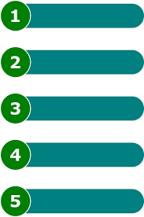
Get to school…
Decomposition
Breaking down a complex problem into simpler parts
Notes:
We all do this in our everyday lives, we are simply not conscious of it. Example: “Teach the class” that is a complex problem… Question: How do you break it down into smaller parts?
Potential “simpler” parts…
Plan your day
Get to school
Go to your class at a specific time
Prepare your class/material
Take attendance
Start the class
Is there a test today? Yes – give instructions.
Etc..
Being able to break a problem down into small parts is a very important skill.
Can you think of a time recently when you broke a problem down to make it easier?
Cleaning a room one section at a time,
Making a snowman: make the pieces first and put them together
puzzles: making the edges first
murals: each person does a little part

Slide 35

Pattern
Recognition
Learning to identify and use similarities to
Simplify
Shorten
Apply similar solutions
Notes:
Example of pattern recognition:
Rabbit or Duck?
The first time you saw this, chances are you didn’t see both: someone had to point the alternative out to you.
Q. What are other examples of pattern recognition?
A. Possibilities include…
Facial Expressions!
Poetry: rhymes
Music: melodies, harmonies, chorus
Chess: how the pieces move

Slide 36
Let’s start Scratch!
Visit:
http:// scratch.mit.edu
Create an account

Slide 37
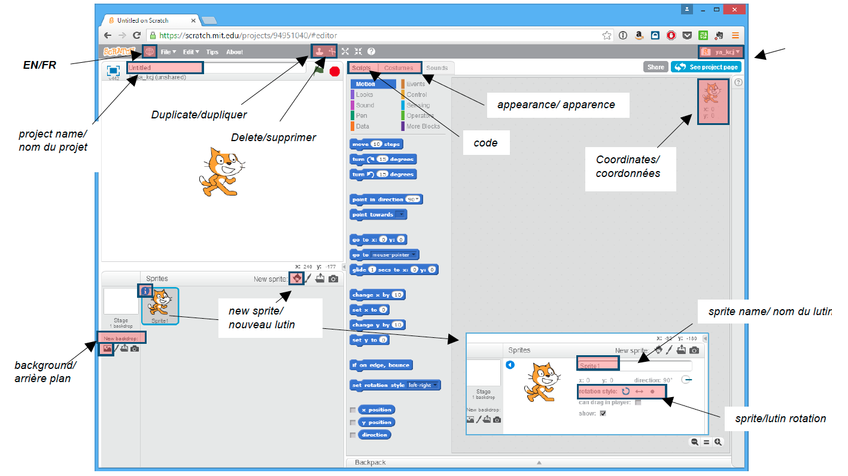

Slide 38
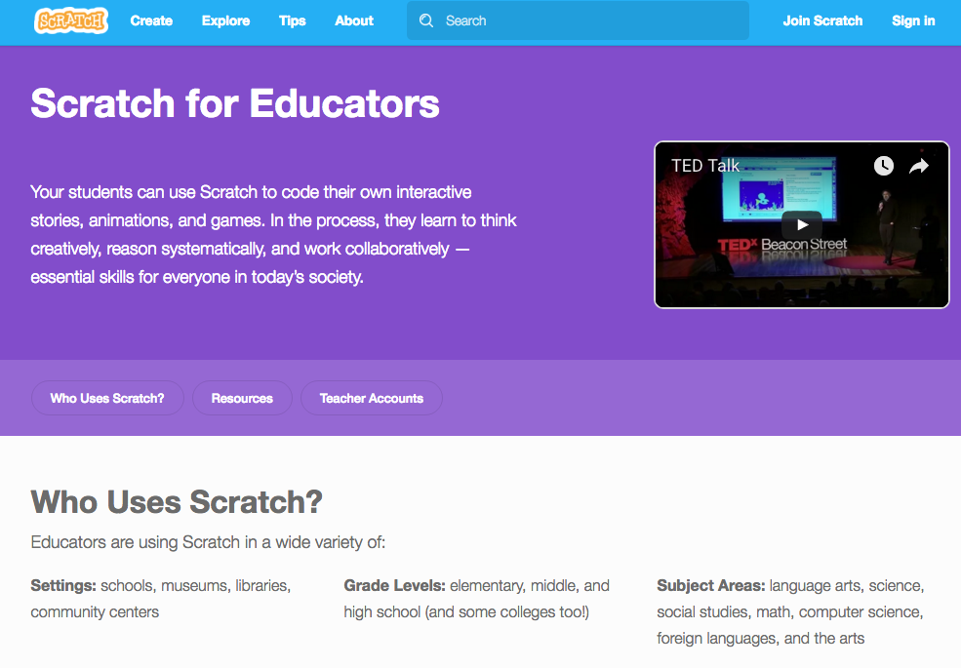
Scratch Teacher Accounts: simple classroom management

Slide 39
Questions? Suggestions? We’d love to hear from you. educators@kidscodejeunesse.org
www.kidscodejeunesse.org

Slide 40

This project was funded by CIRA’s Community Investment Program.

Slide 41
ADDITIONAL INFORMATION & CHALLENGES

Slide 42
COMPUTATIONAL
< Planning >
< Collaborating>
< Experimenting >
< Debugging >
<PRACTICES>
THINKING
{CONCEPTS}
{ Algorithms }
{ Decomposition }
{ Abstraction }
{ Pattern Recognition }
{ Logic }
/PERSPECTIVES/
/ Expressing /
/ Understanding /
/ Connecting /
Notes:
Instructor notes Introduce this as the big picture. Three key dimensions to Computational Thinking (Brennan & Resnick, AERA 2012): computational concepts, computational practices, computational perspectives
They are concepts that you already master, whether formally or not (you may be better at some than others…which is true for everyone)
Explain it clockwise: Computational concepts put into action are Practices, and that leads to Perspectives.
Explain to teachers that even though some of these concepts might seem like a giant black-hole now, they already use and understand many of them daily as we will see in next set of slides
End on Perspectives as the reason why we would want to learn and teach computational thinking,
Concepts Concepts that designers use as they program; these concepts are common to all programming and transfer to non-programming contexts
Algorithm: a series of step-by-step instructions
Decomposition: breaking down a complex problem into simpler parts
Abstraction: keeping essential characteristics/information (from the latin abs- “away from” and “trahere” -draw)
Logic: Analyzing and predicting
Pattern Recognition: learning to identify and use similarities in order to: simply, shorten, apply similar solutions
Practices:
Practices designers develop as they program: it is the process of construction and design. Practices focus on the process of thinking and learning, moving beyond the “what” you are learning to the “how” you are learning.
Experimenting: trial and error, testing new things, having an idea and trying to see how to make it work (incremental & iterative process)
Debugging: Answering the question “Does it work the way I want it to?” If the answer is “No”, figure out why then fix it. (incremental & iterative process)
Collaboration:
Planning:
Perspectives:
Designers evolve their understanding of the technological world around them, their relationship with others, and of themselves.
Expressing = computer programming can be a means of expressing oneself because it is a tool, it can be used in many different ways (web pages, art, music, games, etc…) just like a pencil can be used to write a report or draw a picture.
Understanding = being better able to understand today’s sociotechno reality - being able to recognize and use some of the tools that create this reality
Connecting = creativity and learning are deeply social practice, facilitate being able to reach out to others in a new ways (creating with others and creating for others)

Slide 43



Abstraction
Reducing to a set of essential characteristics
Summarizing
Non-realistic models
Notes:
“Abstract” comes from the latin “abs-” = away from and “trahere” = draw. Abstraction is taking away/removing in order to reduce something to a set of essential characteristics (established by convention). Focus on the essentials then add to details in order to make it essential/important information more accessible/understandable: colours, shapes, textures, numbers…
What do these images have in common?
They are all non-realistic representations of things. There are established conventions so that we can communicate and recognize the representation as being the same thing. Globe: We recognize the shape right away, but what if it were red? Then what planet would we be looking at? Cat: We can all agree it is a cat, what would it take to make it a tiger? It’s already orange… Traffic light: We recognize this arrangement of colours…what do they mean?
Computer animation is a very common form of computational abstraction: it is one of the ways we use programming as a means of expression.

Slide 44
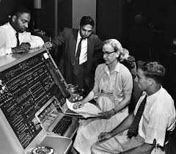
HUMAN-
FRIENDLY LANGUAGE
translator
MACHINE-CODE
Computers need instructions written in machine-code…
Grace Hopper
Notes:
Computer code is how instructions are given to a computer to perform a specific task.
Computers understand binary code: that is sequences of ones and zeros.
At the beginning of modern computing, a major issue preventing the wider use of computers: there was no way for anyone who was not highly trained and
highly mathematical to program computers. Grace Hopper and her team created the first compiler for computer languages: the computer would take
instructions written in a human-friendly language and translate them into machine code. (In computing science, such a translator is called a compiler.)
Humans are built to code and de-code information.
If you’ve learned to read and write, learned basic math, learned a recipe, you’ve already developed some coding skills that you can transfer to the project of learning computer code.
YOU ALREADY KNOW HOW TO CODE!
You are just learning one more way to do it.

Slide 45
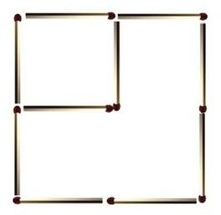
Matchstick Challenge The are 2 squares. Move only 2 matchsticks
to create 3 squares.
Notes:
Pattern recognition, logic, decomposition

Slide 46
Matchstick Challenge SOLUTION
Notes:
Pattern recognition, logic, decomposition

Slide 47
Logic
Analysing and predicting (cause & effect)
Challenge: solve the problem…
If today is Friday, what is
the day after the day before
the day before tomorrow?
Notes:
Logic is using what we know to analyze what we observe and predict what should occur: cause and effect.
Computational thinking challenge: Show the challenge and ask immediately “Is this a simple question?”

Slide 48
Applying
decomposition,
logic
and
pattern recognition
If today is Friday, what is
the day after
the day before
the day before
tomorrow?
Notes:
What about looking at it differently? Let’s change the formatting…

Slide 49
Applying decomposition,
logic
and
pattern recognition
If today is Friday, what is
the day after
the day before
the day before
tomorrow?
Notes:
What about looking at it differently? We can change the formatting some more: Which do you find easier to understand: the first or the second organization of information? Why? Now let’s solve it! Let the participants work it out, Raise your hand when you’re ready…(gives everyone a bit of time) There are two ways to solve it: start with “tomorrow” and work your way up, or start from “the day after” and work your way down.
Answer: it’s today = Friday! Did you notice the pattern?
“day after + day before” and then
“day before + tomorrow” which can be substituted with “day before + day after” so these two lines cancel each other out...
Indenting allows you to see the “inside-out”, “bottom-up” possibilities more easily and is something that is widely used in computer programming languages as a way to organise the code.

Slide 50
Applying
decomposition,
logic
and
pattern recognition
Is this a simple problem now?
If today is Friday, what is (the day after (the day before (the day before (tomorrow))))?
Notes:
Now that you’ve worked through it and solved it, here’s one final way of looking at it. Let’s change the formatting slightly… Adding parentheses is a concise way of decomposing the problem, each set indicates a new line (and an indentation)… How is this useful? (go to next slide)

Slide 51
Applying
logic, decomposition
and
pattern recognition
Second computational thinking challenge:
Add all the numbers from 1 to 200, in 10 seconds, in your head.
Notes:
Additional computational thinking challenge- if time permits.

Slide 52
Clearly, we need to use a different algorithm than…
1 + 2 + 3 + …. + 198 + 199 + 200
to meet the challenge’s requirements
Can someone recognize a pattern that will help define a new algorithm?
Notes:
By adding 1 to 200 we get 201, 2 to 199 we get 201, etc. This gives us a pattern that from which we can create a simple algorithm: into a simple formula 201 x 100 (pairs).
Solving this problem uses decomposition, logic and pattern recognition. We’ve reduced a very long algorithm, into a much simpler efficient one through Computational Thinking.

Slide 53
Computational thinking at work…
Logic
Pattern Recognition
Decomposition
Algorithm
What if we look at the problem like this…
1 + 200 = 201
2 + 199 = 201
…
100+101 = 201
Then we have 100 pairs that each add up to 201…
Notes:
If we add 1 to 200 we get 201, 2 to 199 we get 201, etc. This gives us a pattern that from which we can create a simple algorithm: into a simple formula 201 x 100 (pairs).
Solving this problem uses decomposition, logic and pattern recognition. We’ve found an efficient algorithm through Computational Thinking. We have improved our skills in decomposition, logic and pattern recognition and learned a new algorithm to solve a similar problem the next time it is encountered

Slide 54
Please tell us what you think!
[Survey Link]
[Instructor’s Name] educators@kidscodejeunesse.org
www.kidscodejeunesse.org

Slide 55
This project was funded by CIRA’s Community Investment Program.

